Slide 1

Baseball Data
Across the World
Brennan Dahl, Adam Daily,
Michel Jakobitz

Slide 2
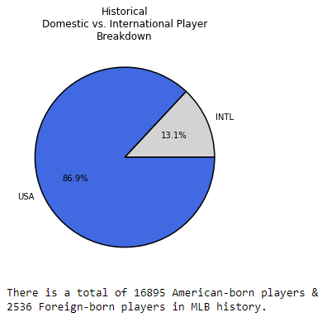
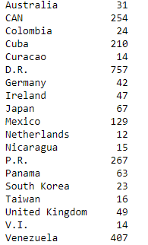
Where do players come from?
Total Countries - 56

Slide 3
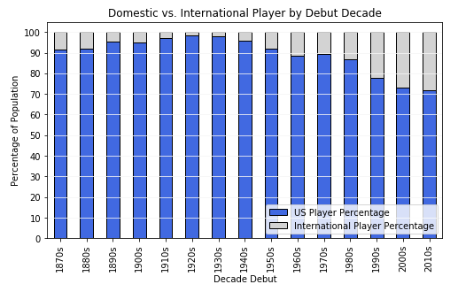
Players over the decades

Slide 4
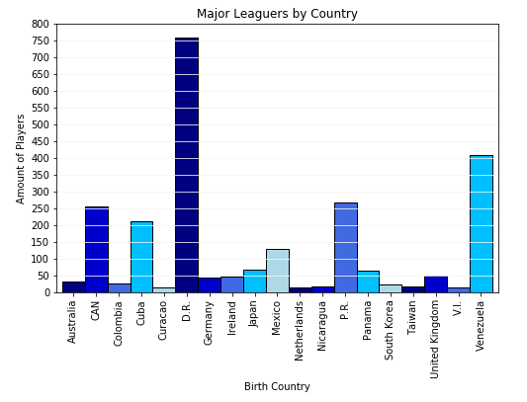
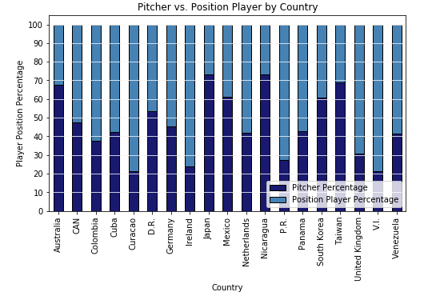
Players by Country

Slide 5
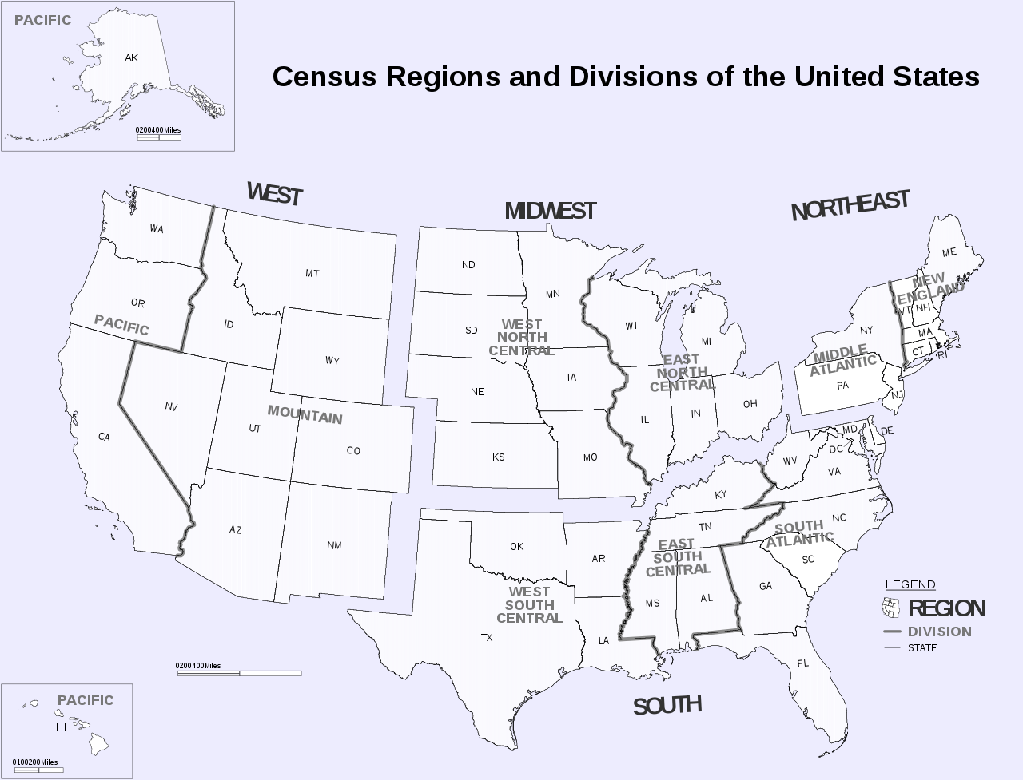
US Census Region Map
Regions
Pacific
Mountain
West North Central
West South Central
East North Central
East South Central
New England
Middle Atlantic
South Atlantic

Slide 6
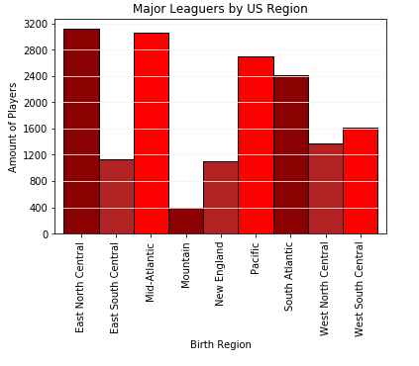
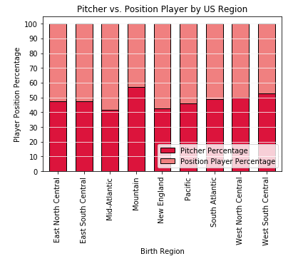
Players in the US

Slide 7
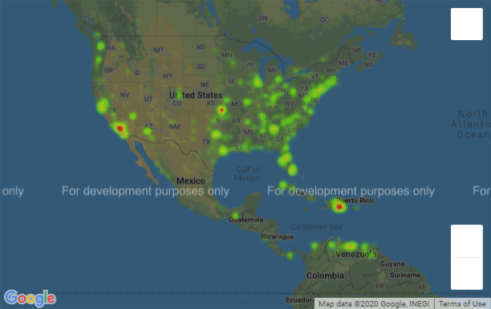
Heat Map
Players who played
in 2019

Slide 8
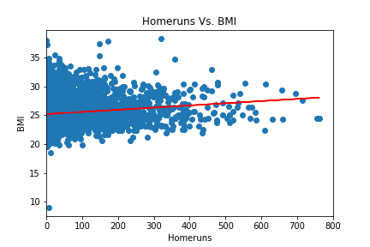
Regression on homerun data
R-Value of 0.14
Line Equation = 0.004x+25.2

Slide 9
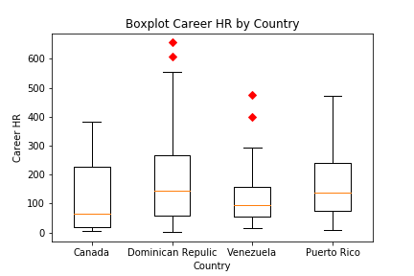
Career HR’s of Top Countries
-Excludes USA
Outliers
- Sammy Sosa (DR)
- Albert Pujols (DR)
- Miguel Cabrera (VEN)
- Andres Galarraga (VEN)

Slide 10
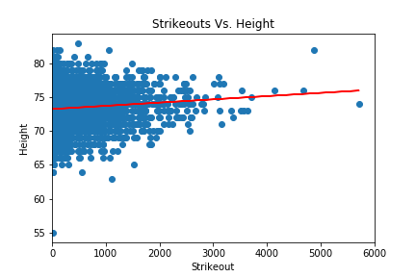
Strikeouts Vs. Height
R-value of 0.08
Line Equation = 0.0005x + 73.24

Slide 11
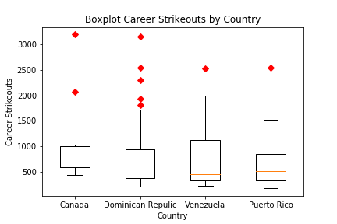
Career Strikeouts by Country
Excludes USA
Outliers
Ryan Dempster (CAN)
Fergie Jenkins (CAN)
Bartolo Colon (DR)
Ervin Santana (DR)
Francisco Liriano (DR)
Pedro Martinez (DR)
Felix Hernadez (VEN)
Javier Vazquez (PR)

Slide 12

Wrap Up
US is the dominant force throughout Baseball history
Foreign players are on the rise
Preconceived notions about player build and performance doesn’t match the data

